Slide 1
Find My Past British and Irish Research
Dr. Thomas A. Montgomery

Slide 2
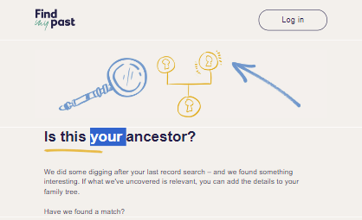
FindMyPast
Findmypast offers a unique collection of records that can help you uncover your family history. Let’s dive into the details.

Slide 3
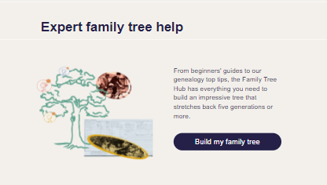
Why It Matters
Findmypast’s British & Irish roots collection is a first-of-its-kind resource, allowing North American family historians to search for their British and Irish roots all in one place.
It covers individuals emigrating from the United Kingdom or Ireland to the United States, Canada, or the Caribbean, as well as those listed on U.S. or Canadian collections with British or Irish origins.
Trace your ancestors’ journeys across the Atlantic with this comprehensive collection.

Slide 4
The British & Irish Roots Collection
This curated collection brings together 98 million records specifically identifying British or Irish emigrants.
It includes a variety of valuable migration clues, such as passenger lists, census records, naturalization applications, draft registrations, and birth, marriage, and death records.

Slide 5
The British & Irish Roots Collection
Each result provides a transcript with details varying based on the original source material.
Some facts you may discover about your ancestors include their name, sex, age, birthplace, nationality, origin country, residence, and destination country.
You can even view the original source records in most cases.

Slide 6
The British & Irish Roots Collection
Baltimore passenger lists (1846-1851)
Britain’s registers of licenses to pass beyond the seas (1573-1677)
British & Irish Roots Collection | findmypast.com

Slide 7
FindMyPast
Enjoy the Journey!

